Slide 1

Presentation for
Training Report
on
Mushroom Edibility Classification Using Logistic Regression
Arvind Singh
Roll No. 12301120
Punjabi University, Patiala
Mentored By:
Dr. Gurjit Singh Bhathal

Slide 2
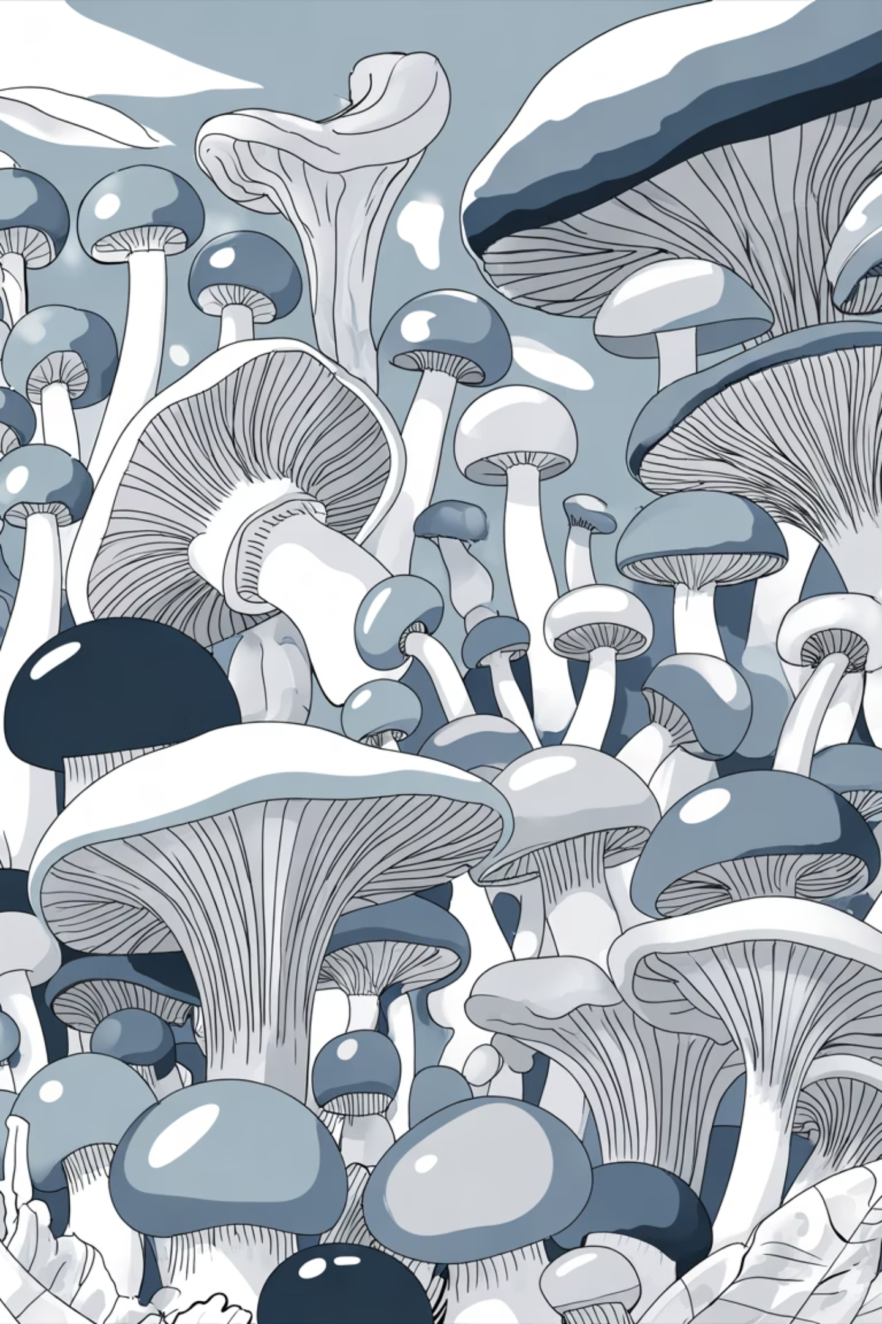
Project Motivation
Mushroom poisoning continues to pose a major public health challenge worldwide, primarily due to the accidental consumption of toxic species resulting from misidentification. Distinguishing between edible and poisonous mushrooms can be extremely difficult, even for experts, as many share similar physical characteristics. This project leverages the power of machine learning to accurately classify mushrooms as either edible or poisonous based on their observable attributes such as color, shape, and texture. By developing a data-driven model for mushroom identification, this work aims to reduce the risks associated with foraging and consumption, promote safer food practices, and contribute to broader food safety and public health initiatives.

Slide 3

About Novem Controls
Organization Overview
Novem Controls is a forward-thinking organization committed to advancing machine learning education and practical AI applications in real-world scenarios. They provide mentorship, resources, and collaborative opportunities for students to develop technical expertise and apply ML techniques to meaningful problems.
Novem Controls was established in 1999 and are an ISO 9001:2008 certified company. They are a team of technocrats and professionals providing Website Development, App Development, Digital Marketing, and ERP Development.

Slide 4
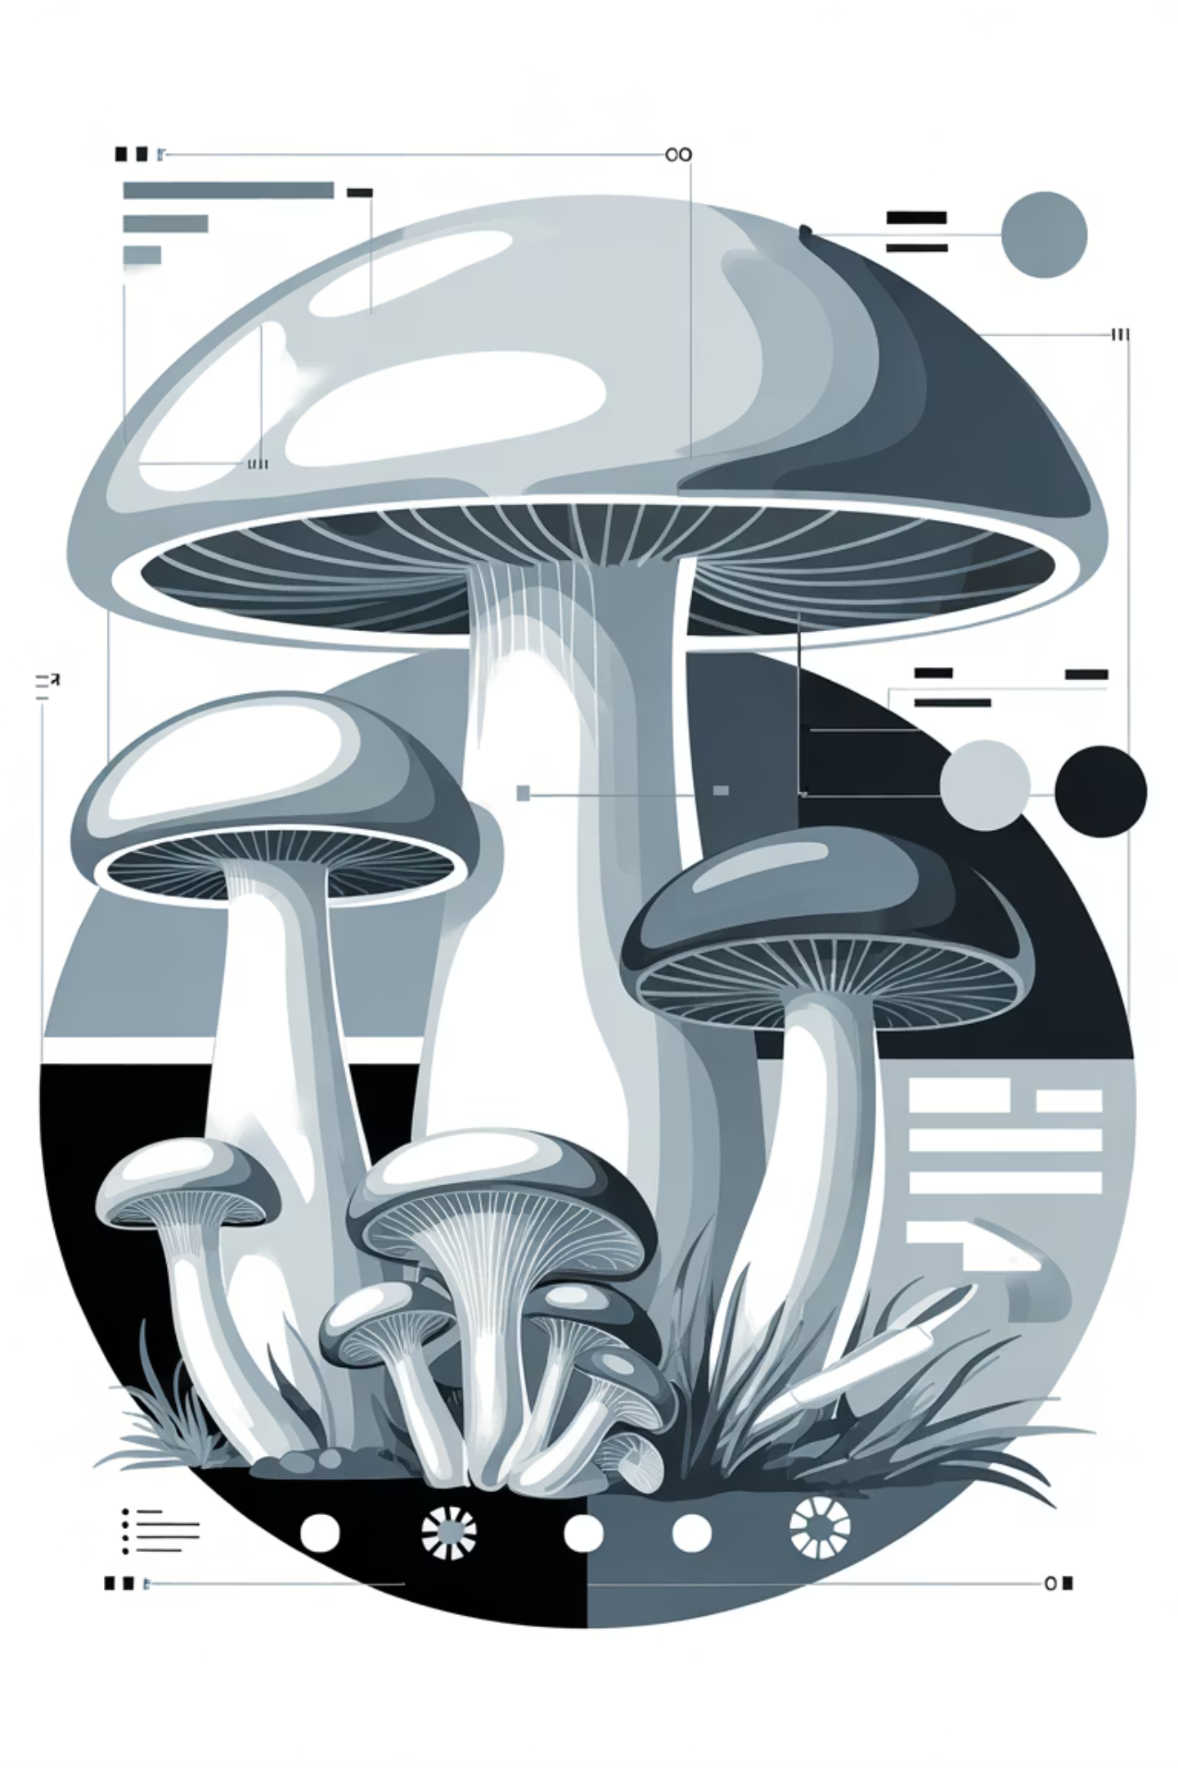
Dataset Overview
📊 Data Source
UCI Mushroom Dataset from Kaggle
📈 Sample Size
8,124 instances
🏷️ Attributes
23 categorical features
🎯 Target
Binary classification (Edible/Poisonous)
Key Features: Cap shape, cap surface, cap color, bruises, odor, gill attachment, gill spacing, gill color, stalk shape, stalk root, veil type, veil color, ring number, spore print color, habitat, and population characteristics.

Slide 5
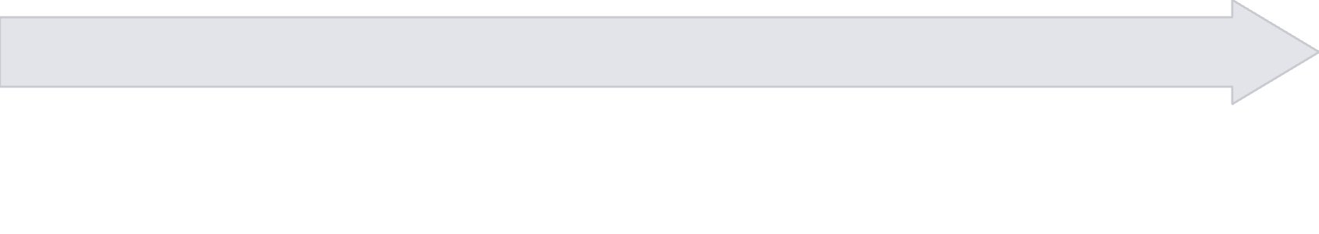

Data Preprocessing Pipeline
Encoding
Scaling
One-Hot Encoding for nominal features; Ordinal Encoding for ordered categorical variables to preserve information structure.
StandardScaler normalization ensures all features have mean=0 and standard deviation=1, improving model convergence.
Train-Test Split
Dataset Ready
Stratified 80/20 split maintains class distribution across training and testing datasets, ensuring representative evaluation.
8124 Total Attributes and 22 Categorical Features and 1 Target Variable are present to make the Dataset Ready to perform Logistic Regression.

Slide 6

Logistic Regression: The Chosen Algorithm
Why Logistic Regression?
Model Architecture
Interpretability: Clear probability-based predictions
Logistic Regression fits a sigmoid curve to map input features to probability scores. For mushroom classification, the model learns optimal weights for each feature, outputting probability of being edible (threshold: 0.5).
Efficiency: Computationally fast for binary classification
Robustness: Proven effective on diverse datasets
Probabilistic: Confidence scores for predictions
Baseline: Establishes foundation for future models

Slide 7
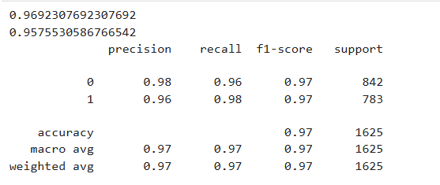

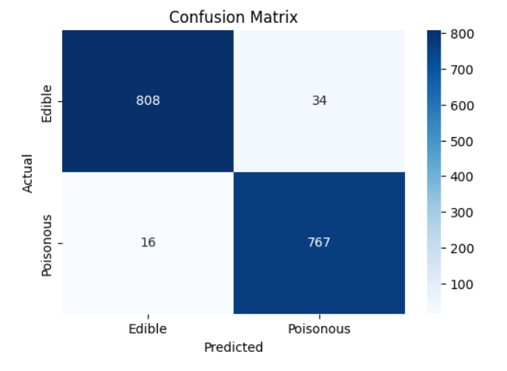
Model Training & Evaluation Metrics
Accuracy
96.9% of predictions correct
Precision
95.8% edible correctly identified
Classification report
Recall
97.6% of actual edibles caught
F1-Score
96.7% balanced performance
The model demonstrates exceptional performance with balanced metrics across both classification classes, indicating minimal false positives and false negatives—critical for public safety applications.
Confusion Matrix

Slide 8
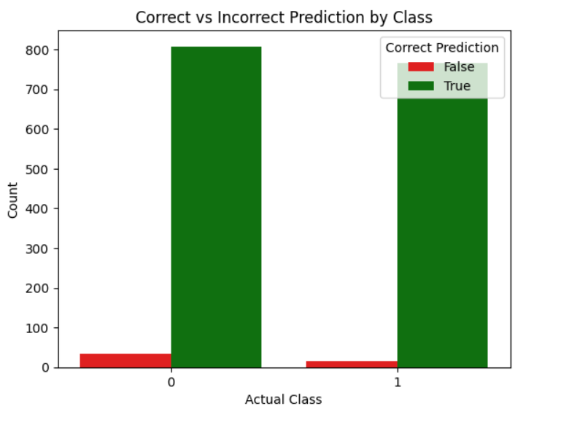
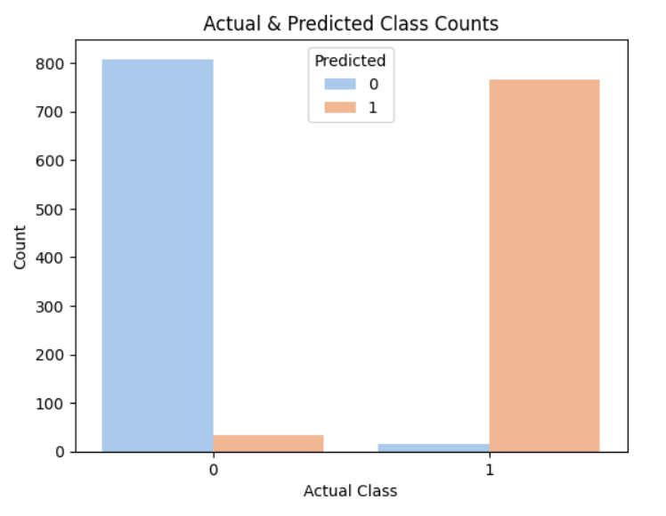
Results & Performance Insights
Class
Precision
Recall
F1-Score
Support
Edible
95.8%
97.6%
96.7%
808
Poisonous
97.5%
96.0%
96.8%
817
Key Findings: The model achieves 96.9% overall accuracy with negligible class imbalance. Only 50 samples misclassified out of 1,625 test instances. Performance is consistent across both edible and poisonous categories, demonstrating robust generalization capabilities suitable for deployment in real-world classification scenarios.

Slide 9





Conclusion & Future Directions
Impact
Achievement
Provides reliable, data-driven tool for mushroom identification, enhancing food safety and public health protection.
Successfully built 96.9% accurate classifier for mushroom edibility using interpretable logistic regression model.
Exploration
Evaluated baseline model establishing foundation for advanced techniques and hyperparameter optimization studies.
Deployment
Develop mobile application interface for field identification; integrate real-time predictions for practical mushroom foraging safety.
Future Work
Implement Random Forest, SVM, and Neural Networks; conduct hyperparameter tuning; test on new datasets for robustness.

Slide 10

Acknowledgements & References
Organizations & Mentors
Libraries & Tools
Data Source
Novem Controls — guidance and resources
Python, Pandas, NumPy — data processing
UCI Mushroom Dataset (Kaggle)
Scikit-learn — machine learning framework
8,124 curated samples
Punjabi University, Patiala — institutional support
23 categorical features
Matplotlib, Seaborn — visualization
Peer-reviewed classification data
Faculty advisors — technical mentorship
Jupyter Notebook — interactive development
For questions, code, or further information, please contact @iarvinddsingh@gmail.com or refer to GitHub : @arvindmatharoo

